Slide 1

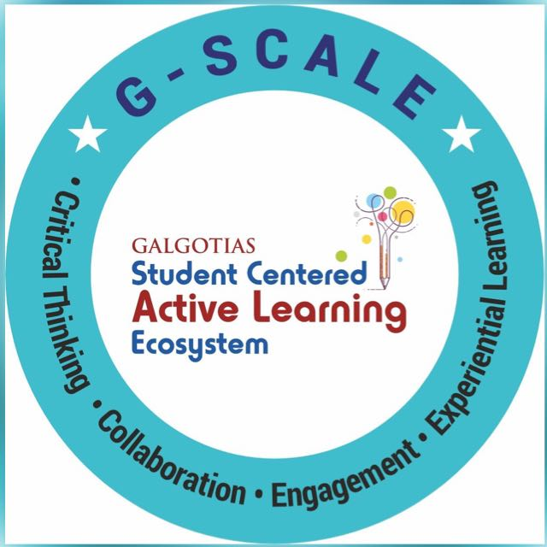
Text Preprocessing → (Tokenization, stopword removal, stemming, lemmatization)
Session No.: 2 Course Name: Natural Language Processing Course Code: R1UC616C Instructor Name: Dr. Deepa Joshi Duration: 50 mins Date of Conduction of Class: 5 Mar 2025

Slide 2
Review of the key concepts of session no. 1
Definition of NLP:
NLP is a branch of AI that enables machines to process, understand, and generate human language.
It helps computers interact with humans in a natural way.
✅ Challenges of NLP:
Ambiguity: Words and sentences can have multiple meanings.
Context Dependence: The same word can have different meanings based on context.
Evolving Language: New words, slang, and trends require continuous model updates.
Pronoun Resolution: Machines struggle to determine references in sentences.
Understanding Sarcasm & Emotions: Machines find it hard to detect tone and hidden meanings.
✅ Applications of NLP:
Chatbots & Virtual Assistants: Siri, Alexa, Google Assistant.
Search Engines: Google Search, Auto-complete, and intent recognition.
Machine Translation: Google Translate, multilingual AI systems.
Social Media Monitoring: Sentiment analysis for brands and trends.
Grammar Checking & Text Correction: Grammarly, Microsoft Word spell check.
Text Summarization & Q&A Systems: AI-powered news summaries, automated customer support.

Slide 3
Reflect on the responses of post session activity

Slide 4
Question?
"You are building a sentiment analysis tool for movie reviews. You notice that users write reviews in many different ways, such as:
'The movie was fantastic!!!'
'It was the worst movie ever :('
'meh, the movie was ok...'
'The movi was gr8' (with typos and abbreviations)
How would you ensure that your tool correctly understands the sentiment of these reviews, even with variations in writing style, typos, and abbreviations?"
"You are designing a chatbot for a pizza delivery service. Customers might type their orders in many different ways, such as:
'I want a large pepperoni pizza.'
'Can I get a pepperoni pizza, large?'
'plz giv me L pep pizza' (with abbreviations and typos)
'I’d like a big pepperoni pizza!!!'
How would you teach the chatbot to understand these variations and process the orders correctly?"

Slide 5
At the end of this session students will be able to
Learning outcome 1: Apply text preprocessing techniques to clean and structure raw text for NLP applications, improving the accuracy and efficiency of language models.

Slide 6
Session Outline
1 Introduction
2 Text preprocessing: cleaning
3 Tokenization
4 Stemming
5 Lemmatization
6 Stop word removal

Slide 7
Text Preprocessing: Cleaning and Structuring Text for Analysis
Before understanding text, a machine must prepare it in a structured form. This step is crucial because raw text contains inconsistencies, extra spaces, punctuation, and irrelevant words that may affect analysis.
Cleaning: Removing noise (e.g., punctuation, emojis, extra spaces).
Normalization: Converting text to a standard format (e.g., lowercase).
Stemming/Lemmatization: Reducing words to their base forms.
Handling Synonyms and Variations: Grouping similar words or ideas.
Without preprocessing, an NLP model might misinterpret text and fail to produce accurate results.

Slide 8
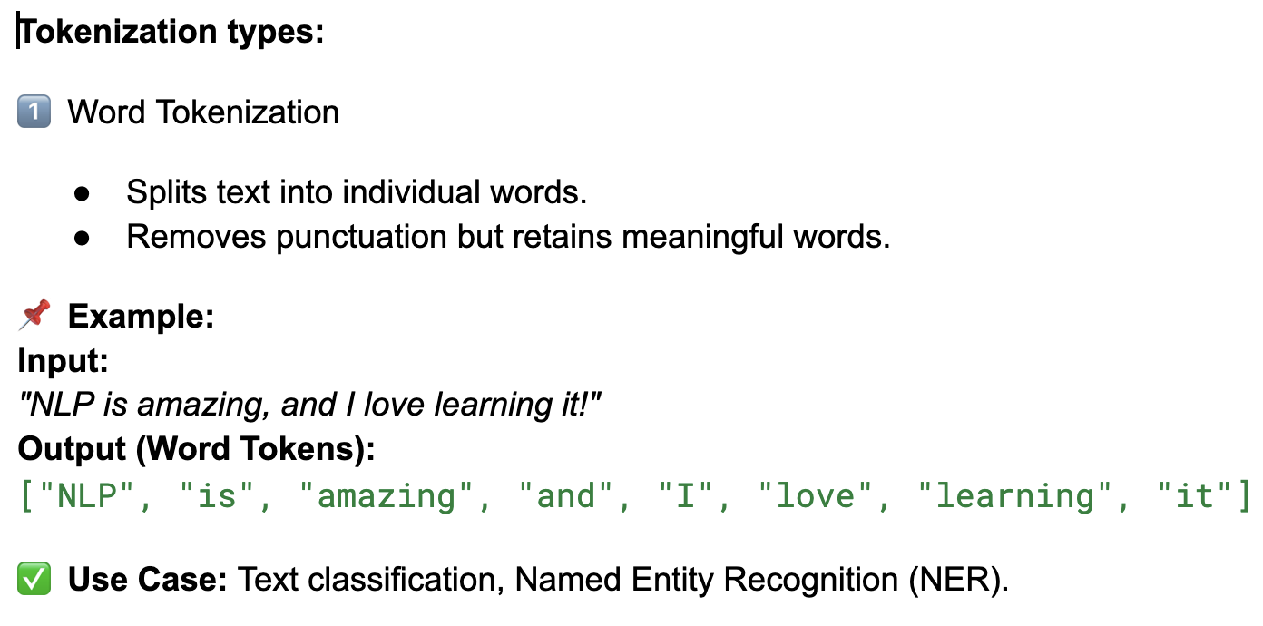
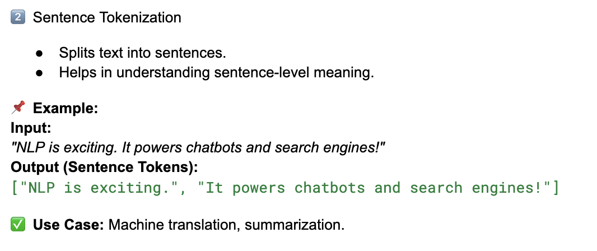
Tokenization
Tokenization is the process of breaking a stream of text into meaningful elements (tokens), such as words, sentences, or subwords, for computational processing in NLP.

Slide 9
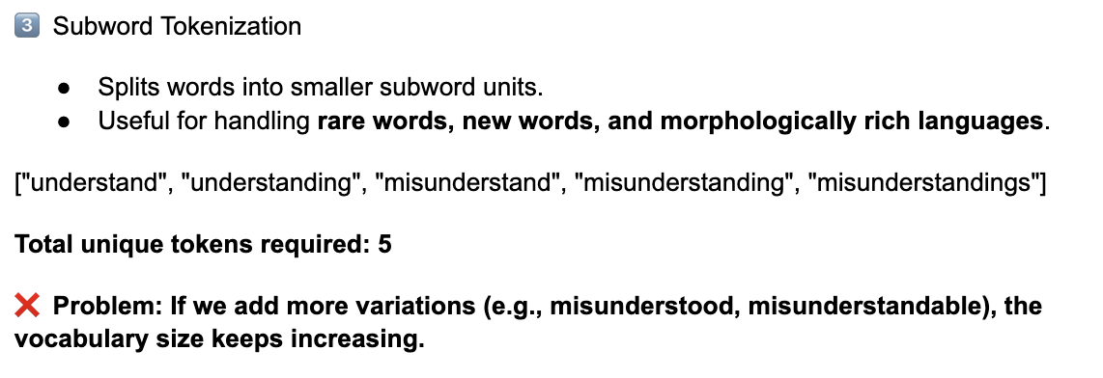
Tokenization

Slide 10
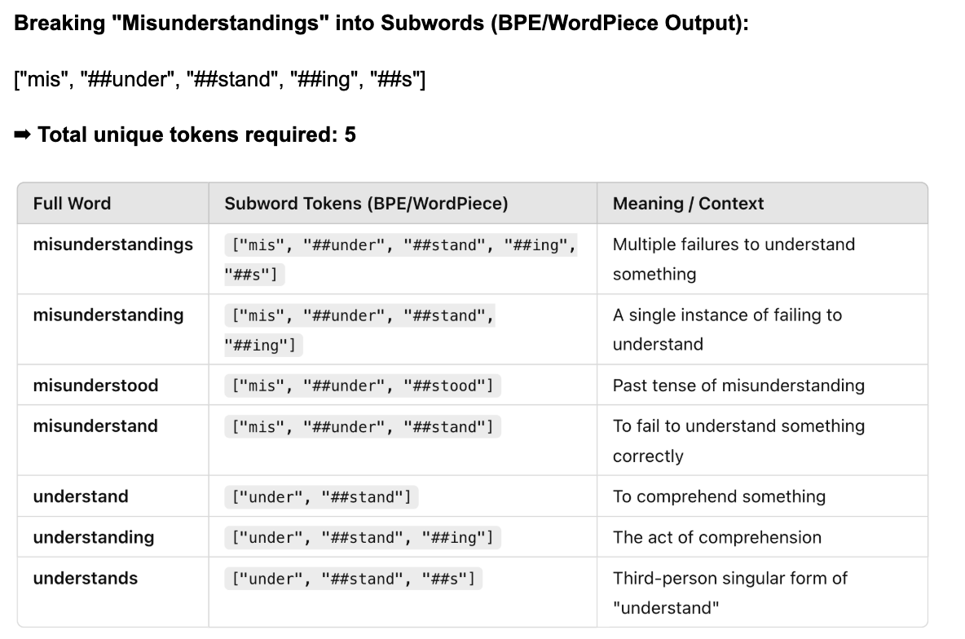

Slide 11
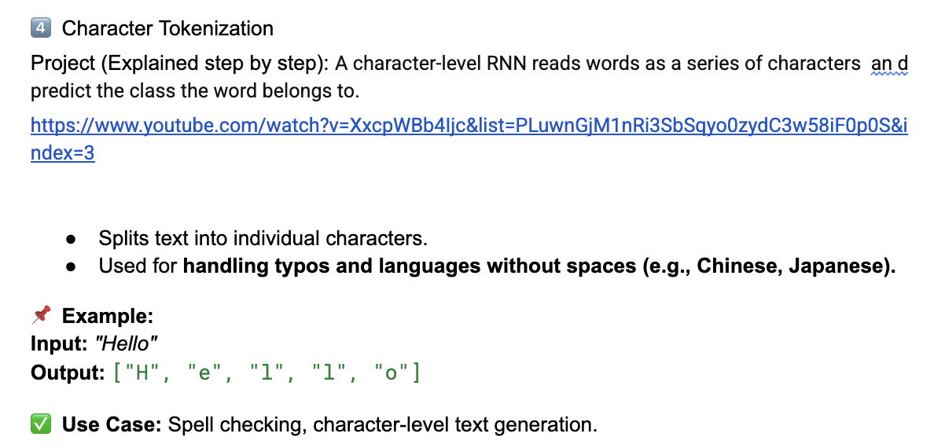

Slide 12
Stopword Removal: Eliminating Unnecessary Words
Stopwords are common words that do not add much meaning to a sentence (e.g., is, the, and, a, this, that).
📌 Example: Input: "The cat is sitting on the mat." Without Stopwords: ➡ "cat sitting mat"
Why Remove Stopwords?
✅ Makes text more meaningful. ✅ Reduces computational cost for NLP models. ✅ Focuses on important words in a sentence.

Slide 13
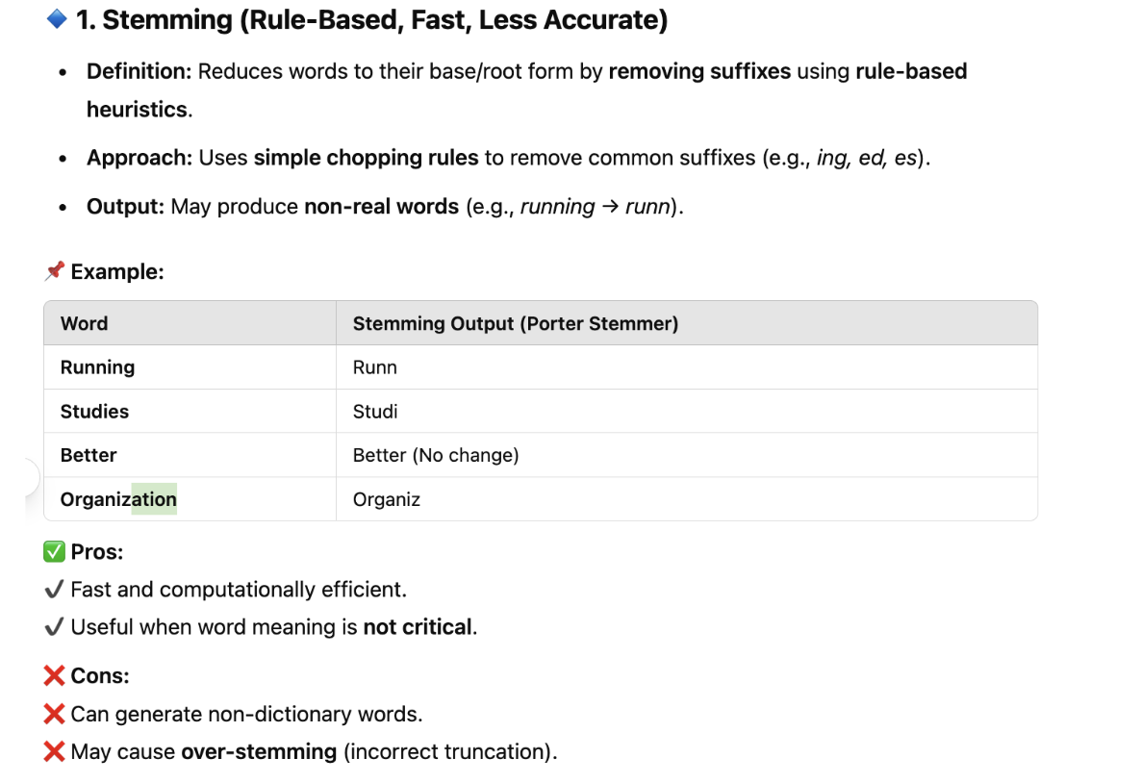
Stemming and Lemmatization

Slide 14
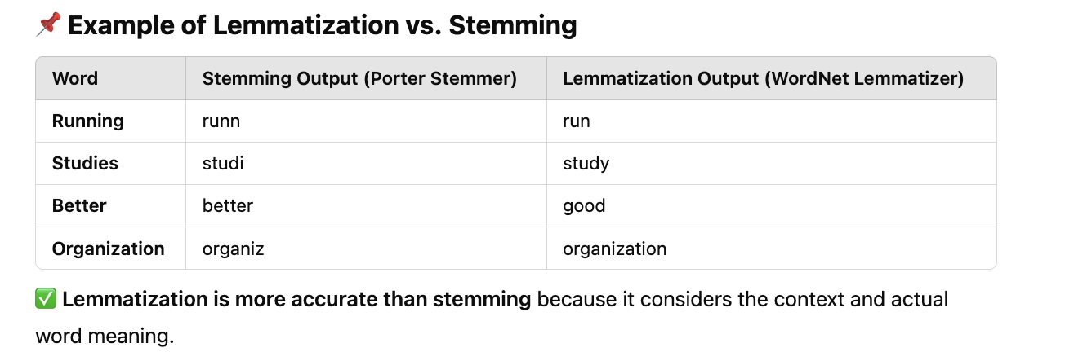
Lemmatization is the process of reducing a word to its base (dictionary) form, known as a lemma, while considering its meaning and grammatical role (Part of Speech - POS).
Unlike stemming, which simply chops off suffixes, lemmatization returns meaningful words that exist in the dictionary.
📌 How Lemmatization Works?
1️⃣ Uses a linguistic dictionary (e.g., WordNet) to determine the base form. 2️⃣ Requires POS tagging to determine whether the word is a noun, verb, adjective, etc.
📌 Example with POS Tags:
"running" (verb) → "run"
"better" (adjective) → "good"

Slide 15
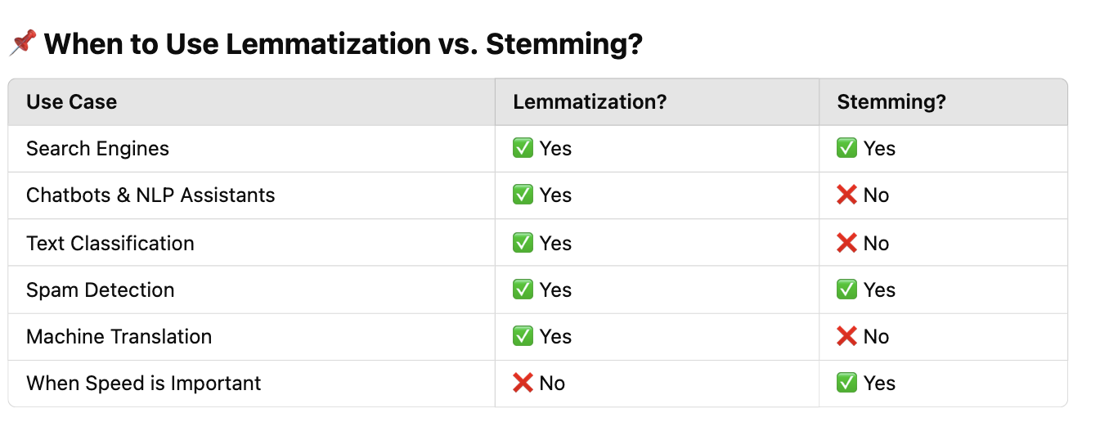

Slide 16
Activity 1
Instructions:
Follow each preprocessing step and write down the transformed text.
📌 Raw Review (Uncleaned Text with Noise & Stopwords):
"I really really loveeee this moviieee!!! 😍😍😍 But it is a bit looooong and slow at times. I guess I liked it overall. The cinematography was amazing, but the story, umm, could have been better! #MovieReview #MustWatch"

Slide 17
Reflection- Learning Activity 1
Step 1: Given Raw Review (Before Preprocessing)
📌 Uncleaned Text: "I really really loveeee this moviieee!!! 😍😍😍 But it is a bit looooong and slow at times. I guess I liked it overall. The cinematography was amazing, but the story, umm, could have been better! #MovieReview #MustWatch"
Step 2: Text Cleaning
📌 Task: Remove special characters, emojis, hashtags, extra punctuation, and elongated words.
✏️ Expected Output: "I really really loveeee this moviieee But it is a bit looooong and slow at times I guess I liked it overall The cinematography was amazing but the story umm could have been better"

Slide 18
Step 3: Tokenization
📌 Task: Break down the sentence into individual words.
✏️ Expected Output: ['I', 'really', 'really', 'loveeee', 'this', 'moviieee', 'But', 'it', 'is', 'a', 'bit', 'looooong', 'and', 'slow', 'at', 'times', 'I', 'guess', 'I', 'liked', 'it', 'overall', 'The', 'cinematography', 'was', 'amazing', 'but', 'the', 'story', 'umm', 'could', 'have', 'been', 'better']
Step 4: Stopword Removal
📌 Task: Remove common stopwords such as "I", "is", "a", "at", "the", "was", "but".
✏️ Expected Output: ['really', 'really', 'loveeee', 'moviieee', 'bit', 'looooong', 'slow', 'times', 'guess', 'liked', 'overall', 'cinematography', 'amazing', 'story', 'umm', 'could', 'better']

Slide 19
Step 5: Stemming
📌 Task: Reduce words to their root form using stemming.
✏️ Expected Output (Porter Stemmer): ['realli', 'realli', 'love', 'movi', 'bit', 'long', 'slow', 'time', 'guess', 'like', 'overal', 'cinematographi', 'amaz', 'stori', 'umm', 'could', 'better']
Step 6: Lemmatization
📌 Task: Convert words to their dictionary base form.
✏️ Expected Output (WordNet Lemmatizer): ['really', 'really', 'love', 'movie', 'bit', 'long', 'slow', 'time', 'guess', 'like', 'overall', 'cinematography', 'amazing', 'story', 'could', 'better']

Slide 20
Summary
1️⃣ Text Cleaning
✅ Removes unnecessary symbols, punctuation, numbers, special characters, and emojis. ✅ Ensures that text is standardized for further processing. 💡 Example: Raw Text: “I loooove NLP!!! 😍 It’s soooo cool!!!” Cleaned Text: “I love NLP It’s so cool”
2️⃣ Tokenization
✅ Breaks text into words or sentences (tokens). ✅ Helps in further processing, such as POS tagging and sentiment analysis. 💡 Example: Sentence: “I love NLP.” Word Tokens: ["I", "love", "NLP", "."] Sentence Tokens: ["I love NLP."]
3️⃣ Stopword Removal
✅ Eliminates common words (e.g., the, is, and, a, in) that do not add much meaning. ✅ Reduces text size and improves computational efficiency. 💡 Example: Before: "The cat is sitting on the mat." After Stopword Removal: "cat sitting mat"

Slide 21
4️⃣ Stemming
✅ Reduces words to their root form using rule-based truncation. ✅ Fast but may produce non-dictionary words (e.g., running → runn). 💡 Example (Porter Stemmer): Before: ["playing", "played", "plays"] After Stemming: ["play", "play", "play"]
5️⃣ Lemmatization
✅ Reduces words to their base form (lemma) while considering grammar (POS tagging). ✅ More accurate than stemming as it returns real words. 💡 Example (WordNet Lemmatizer): Before: ["running", "better", "feet"] After Lemmatization: ["run", "good", "foot"]

Slide 22
Ensure attainment of LOs in alignment to the learning activities: outcomes (1-2)
Learning outcome 1: Apply text preprocessing techniques to clean and structure raw text for NLP applications, improving the accuracy and efficiency of language models.

Slide 23
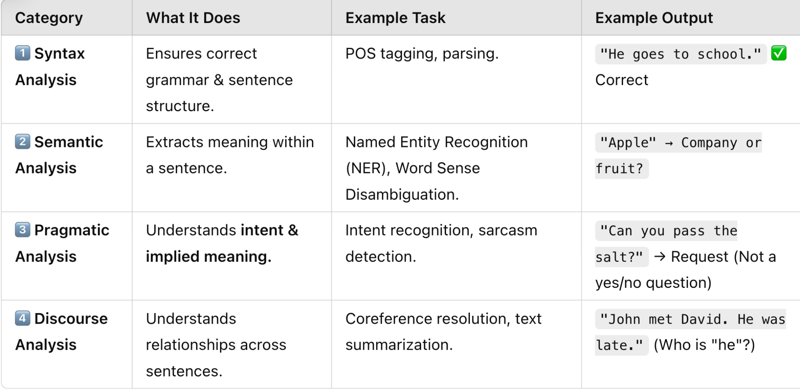
Information about the next lesson
Natural Language Processing (NLP) can be divided into four main categories that help AI understand language at different levels. Each layer builds on the previous one to create a complete understanding of text.

Slide 24

Review and Reflection from students

